Slide 1

Chapter 10
Assymmetric-Key Cryptography
Copyright © The McGraw-Hill Companies, Inc. Permission required for reproduction or display.

Slide 2
Chapter 10
Objectives
To distinguish between two cryptosystems: symmetric-key and asymmetric-key
To introduce trapdoor one-way functions and their use in asymmetric-key cryptosystems
To introduce the knapsack cryptosystem as one of the first ideas in asymmetric-key cryptography
To discuss the RSA cryptosystem
To discuss the Rabin cryptosystem
To discuss the ElGamal cryptosystem
To discuss the elliptic curve cryptosystem

Slide 3
10-1 INTRODUCTION
Symmetric and asymmetric-key cryptography will exist in parallel and continue to serve the community. We actually believe that they are complements of each other; the advantages of one can compensate for the disadvantages of the other.
Topics discussed in this section:
10.1.1 Keys
10.1.2 General Idea
10.1.3 Need for Both
10.1.4 Trapdoor One-Way Function
10.1.5 Knapsack Cryptosystem

Slide 4

10-1 INTRODUCTION
Symmetric and asymmetric-key cryptography will exist in parallel and continue to serve the community. We actually believe that they are complements of each other; the advantages of one can compensate for the disadvantages of the other.
Note
Symmetric-key cryptography is based on sharing secrecy;
asymmetric-key cryptography is based on personal secrecy.

Slide 5
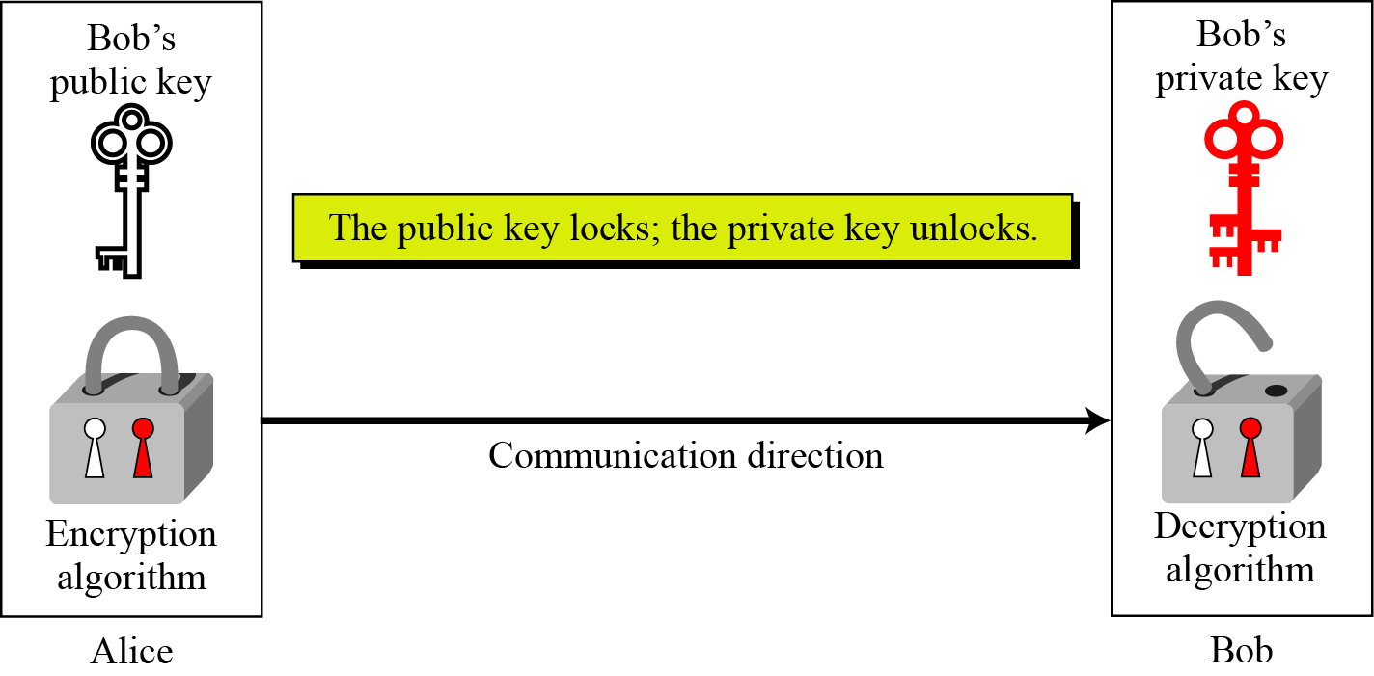
10.1.1 Keys
Asymmetric key cryptography uses two separate keys: one private and one public.
Figure 10.1 Locking and unlocking in asymmetric-key cryptosystem

Slide 6
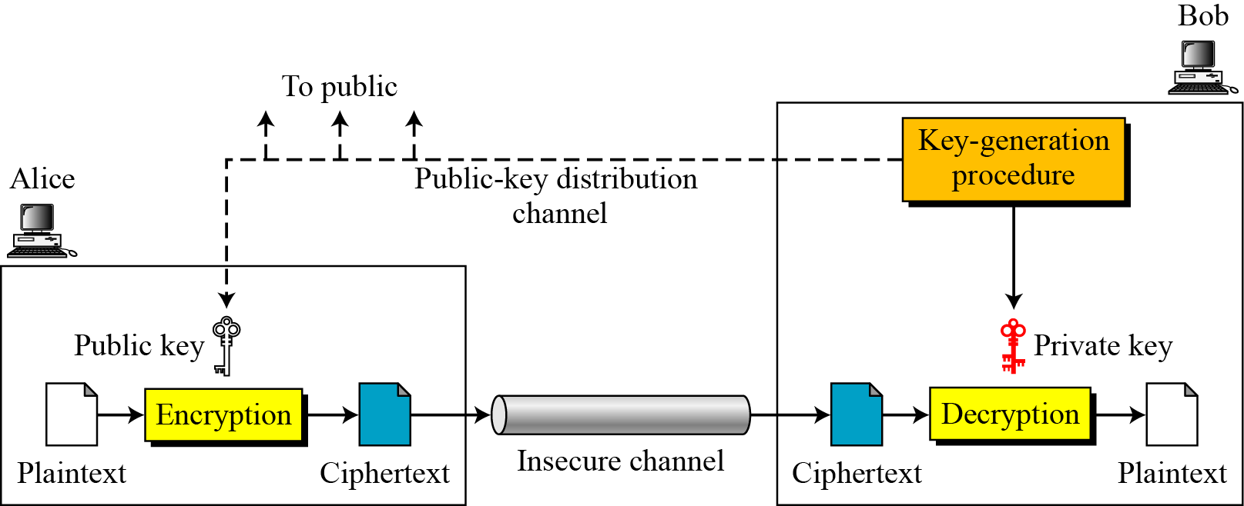
10.1.2 General Idea
Figure 10.2 General idea of asymmetric-key cryptosystem

Slide 7
10.1.2 Continued
Plaintext/Ciphertext
Unlike in symmetric-key cryptography, plaintext and ciphertext are treated as integers in asymmetric-key cryptography.
Encryption/Decryption
C = f (K_{public} , P) P = g(K_{private} , C)

Slide 8
10.1.3 Need for Both
There is a very important fact that is sometimes misunderstood: The advent of asymmetric-key cryptography does not eliminate the need for symmetric-key cryptography.

Slide 9
10-2 RSA CRYPTOSYSTEM
The most common public-key algorithm is the RSA cryptosystem, named for its inventors (Rivest, Shamir, and Adleman).
Topics discussed in this section:
10.2.1 Introduction
10.2.2 Procedure
10.2.3 Some Trivial Examples
10.2.4 Attacks on RSA
10.2.5 Recommendations
10.2.6 Optimal Asymmetric Encryption Padding (OAEP)
10.2.7 Applications

Slide 10
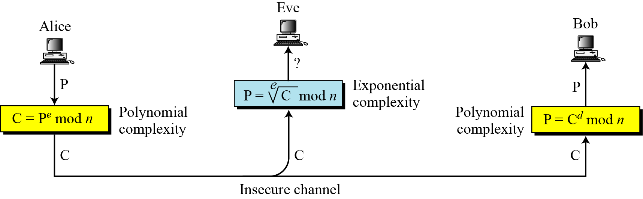
10.2.1 Introduction
Figure 10.5 Complexity of operations in RSA

Slide 11
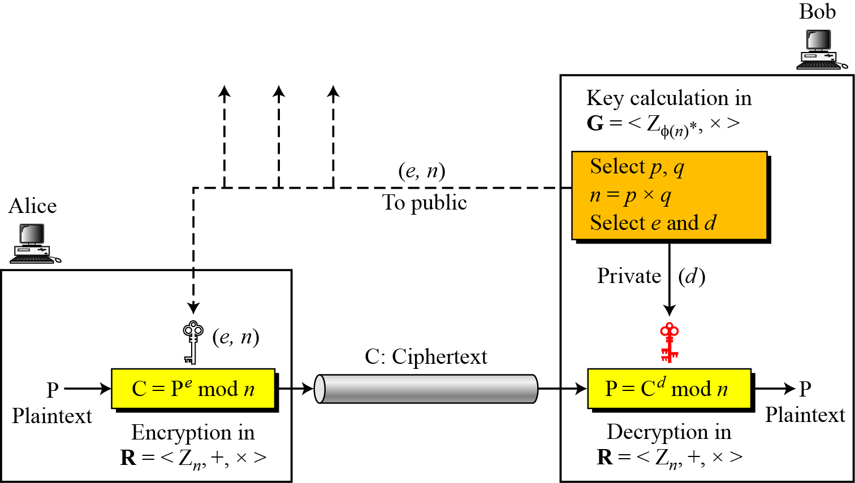
10.2.2 Procedure
Figure 10.6 Encryption, decryption, and key generation in RSA

Slide 12
10.2.2 Continued
Two Algebraic Structures
R = <Z_{n} , +, × >
Encryption/Decryption Ring:
Key-Generation Group:
G = <Z _{φ(n)}∗, × >

Slide 13
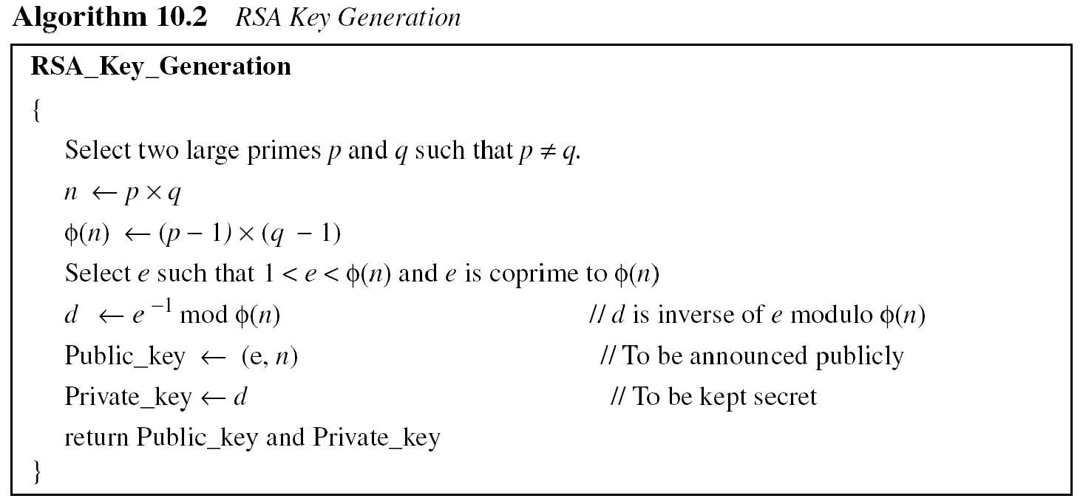
10.2.2 Continued

Slide 14
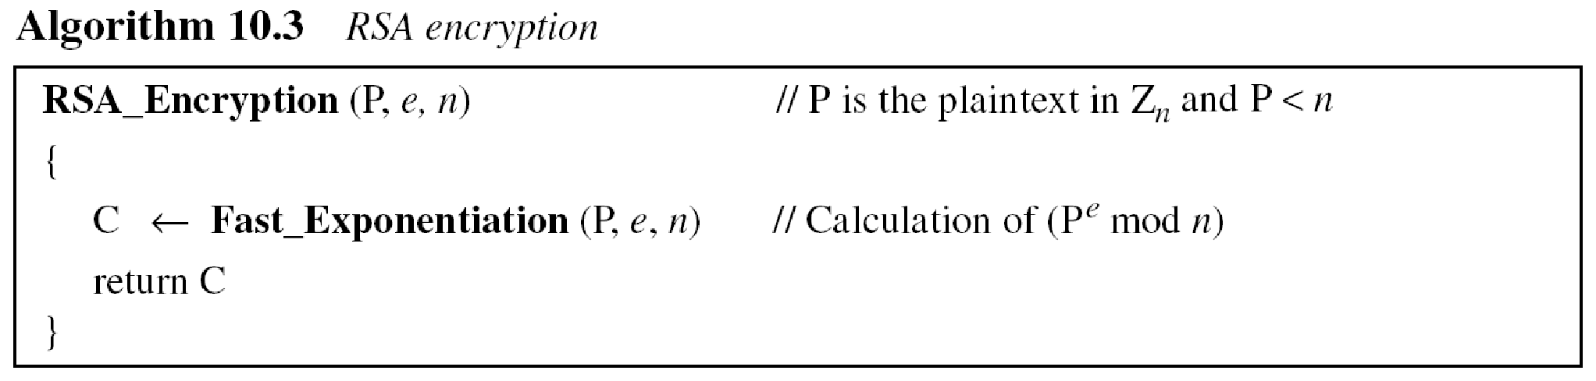
10.2.2 Continued
Encryption

Slide 15
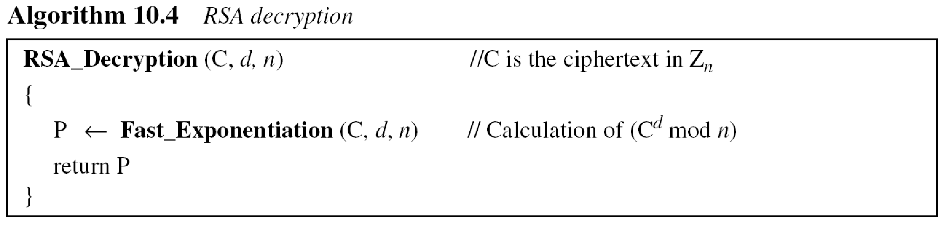
10.2.2 Continued
Decryption

Slide 16
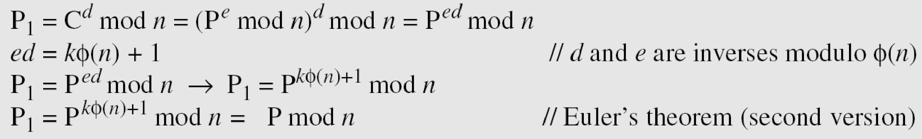
10.2.2 Continued
Proof of RSA

Slide 17
10.2.3 Some Trivial Examples
Example 10. 5
Bob chooses 7 and 11 as p and q and calculates n = 77. The value of φ(n) = (7 − 1)(11 − 1) or 60. Now he chooses two exponents, e and d, from Z₆₀∗. If he chooses e to be 13, then d is 37. Note that e × d mod 60 = 1 (they are inverses of each Now imagine that Alice wants to send the plaintext 5 to Bob. She uses the public exponent 13 to encrypt 5.
Bob receives the ciphertext 26 and uses the private key 37 to decipher the ciphertext:

Slide 18
10.2.3 Some Trivial Examples
Example 10. 6
Now assume that another person, John, wants to send a message to Bob. John can use the same public key announced by Bob (probably on his website), 13; John’s plaintext is 63. John calculates the following:
Bob receives the ciphertext 28 and uses his private key 37 to decipher the ciphertext:

Slide 19
10.2.3 Some Trivial Examples
Example 10. 7
Jennifer creates a pair of keys for herself. She chooses p = 397 and q = 401. She calculates n = 159197. She then calculates φ(n) = 158400. She then chooses e = 343 and d = 12007. Show how Ted can send a message to Jennifer if he knows e and n.
Suppose Ted wants to send the message “NO” to Jennifer. He changes each character to a number (from 00 to 25), with each character coded as two digits. He then concatenates the two coded characters and gets a four-digit number. The plaintext is 1314. Figure 10.7 shows the process.

Slide 20
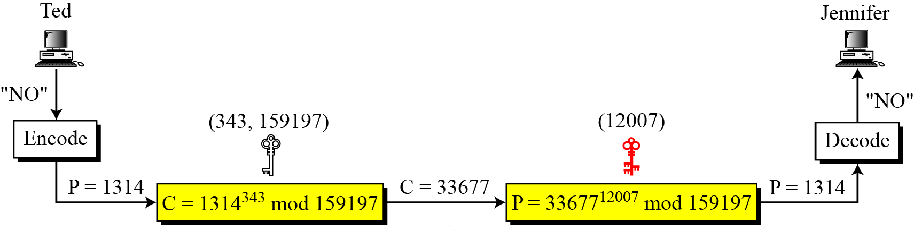
10.2.3 Continued
Figure 10.7 Encryption and decryption in Example 10.7

Slide 21
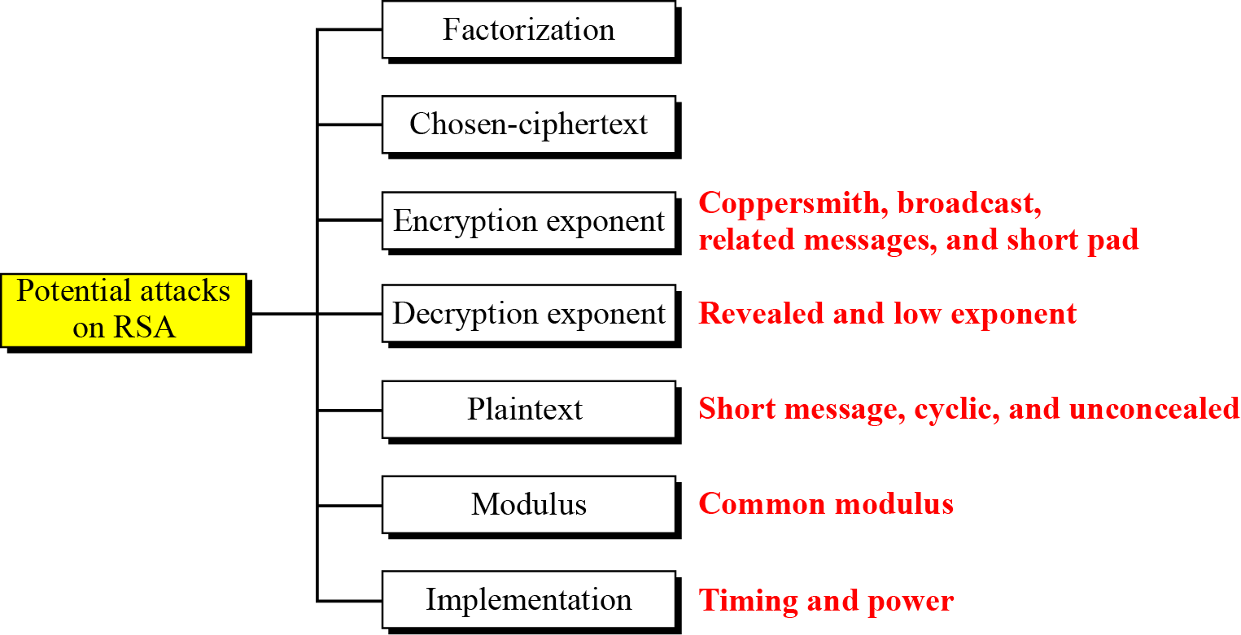
10.2.4 Attacks on RSA
Figure 10.8 Taxonomy of potential attacks on RSA

Slide 22
10-3 RABIN CRYPTOSYSTEM
The Rabin cryptosystem can be thought of as an RSA cryptosystem in which the value of e and d are fixed. The encryption is C ≡ P² (mod n) and the decryption is P ≡ C^{1/2} (mod n).
Topics discussed in this section:
10.3.1 Procedure
10.3.2 Security of the Rabin System

Slide 23
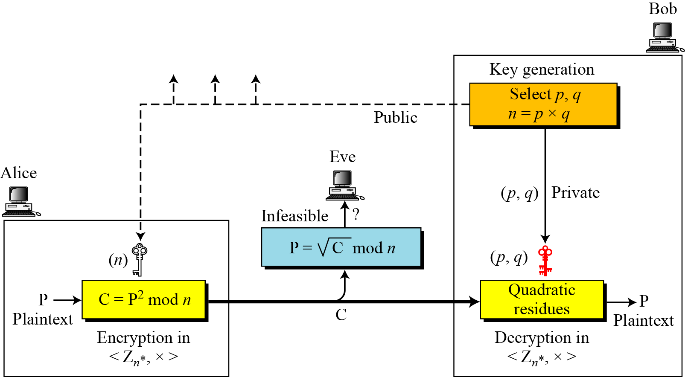
10-3 Continued
Figure 10.10 Rabin cryptosystem

Slide 24
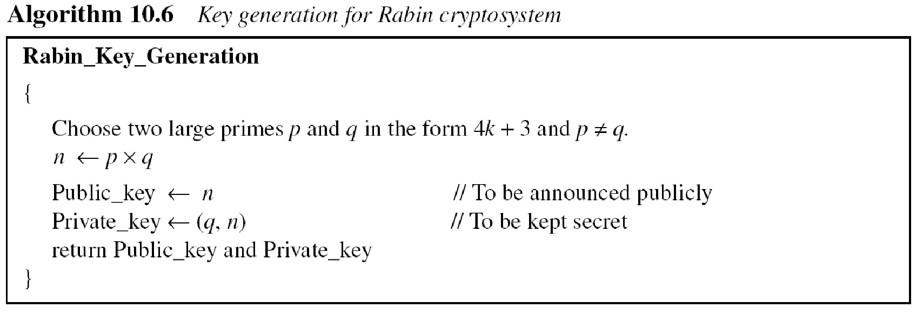
10.3.1 Procedure
Key Generation

Slide 25
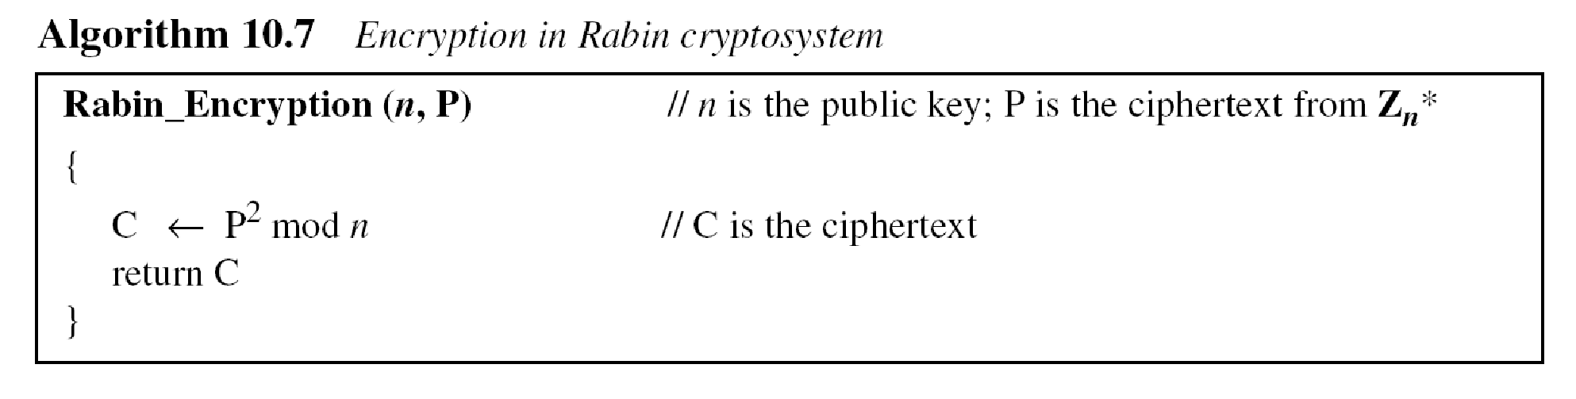
10.3.1 Continued
Encryption

Slide 26
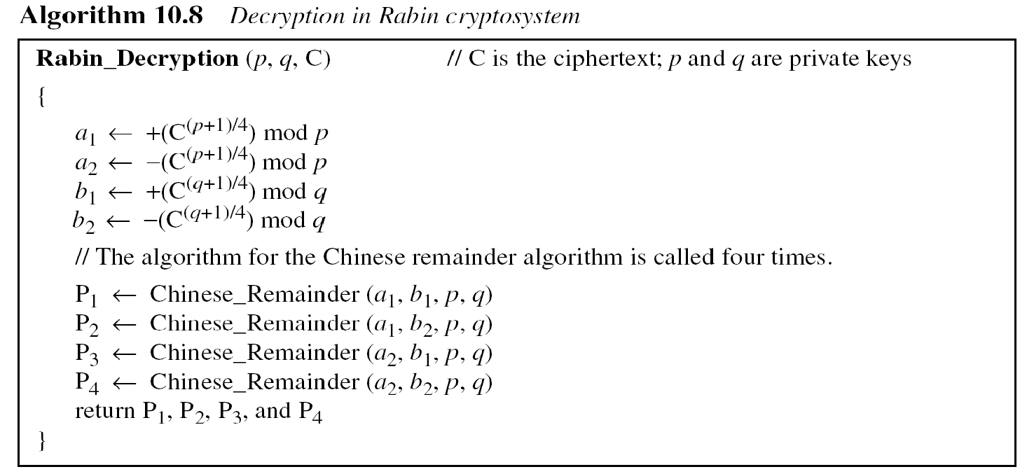
10.3.1 Continued
Decryption
Note
The Rabin cryptosystem is not deterministic: Decryption creates four plaintexts.

Slide 27
10.3.1 Continued
Example 10. 9
Here is a very trivial example to show the idea.
Bob selects p = 23 and q = 7. Note that both are congruent to 3 mod 4.
Bob calculates n = p × q = 161.
Bob announces n publicly; he keeps p and q private.
Alice wants to send the plaintext P = 24. Note that 161 and 24 are relatively prime; 24 is in Z₁₆₁*. She calculates C = 24² = 93 mod 161, and sends the ciphertext 93 to Bob.

Slide 28
10.3.1 Continued
Example 10. 9
Bob receives 93 and calculates four values: a₁ = +(93 ^{(23+1)/4}) mod 23 = 1 mod 23 a₂ = −(93 ^{(23+1)/4}) mod 23 = 22 mod 23 b₁ = +(93 ^{(7+1)/4}) mod 7 = 4 mod 7 b₂ = −(93 ^{(7+1)/4}) mod 7 = 3 mod 7
Bob takes four possible answers, (a₁, b₁), (a₁, b₂), (a₂, b₁), and (a₂, b₂), and uses the Chinese remainder theorem to find four possible plaintexts: 116, 24, 137, and 45. Note that only the second answer is Alice’s plaintext.

Slide 29
10-4 ELGAMAL CRYPTOSYSTEM
Besides RSA and Rabin, another public-key cryptosystem is ElGamal. ElGamal is based on the discrete logarithm problem discussed in Chapter 9.
Topics discussed in this section:
10.4.1 ElGamal Cryptosystem
10.4.2 Procedure 10.4.3 Proof
10.4.4 Analysis
10.4.5 Security of ElGamal
10.4.6 Application

Slide 30
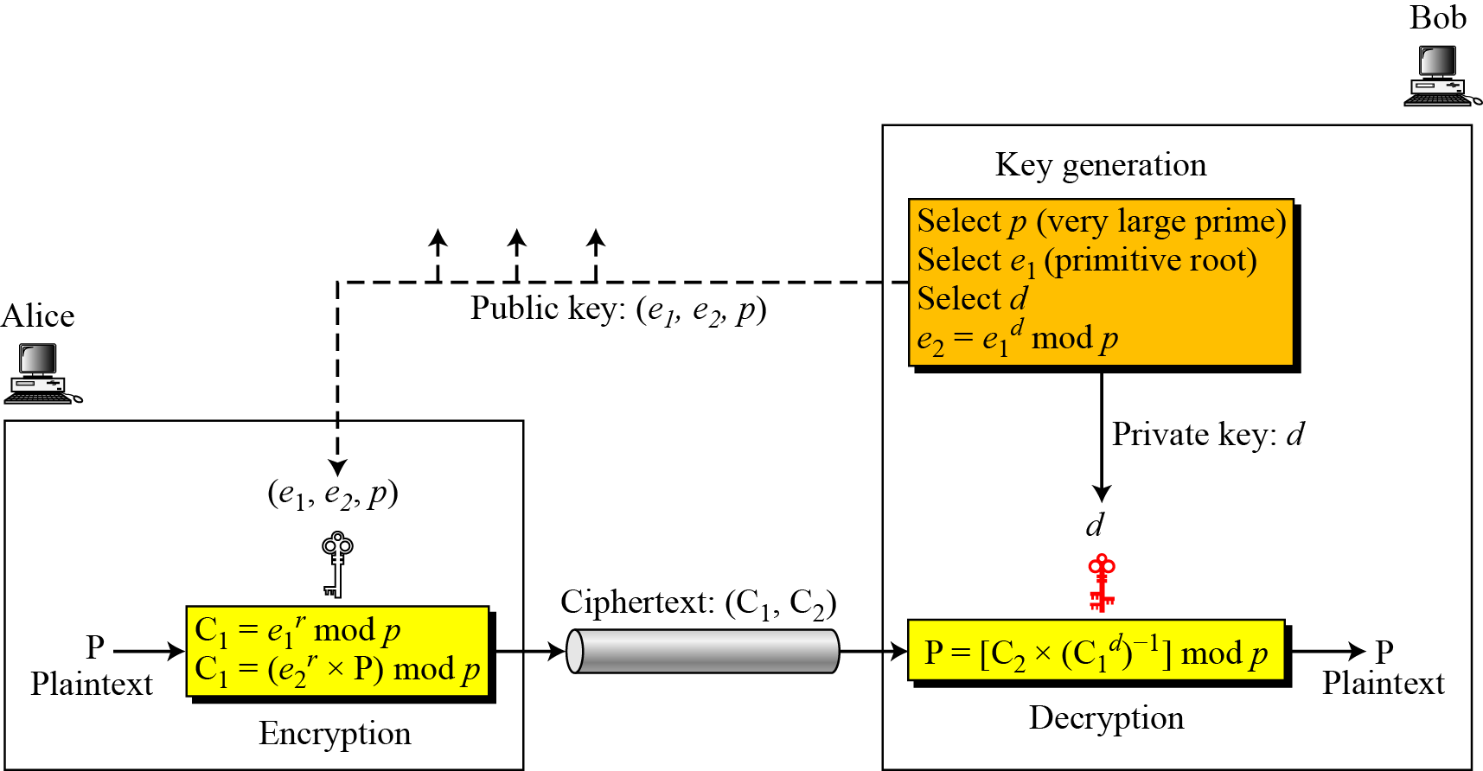
10.4.2 Procedure
Figure 10.11 Key generation, encryption, and decryption in ElGamal

Slide 31
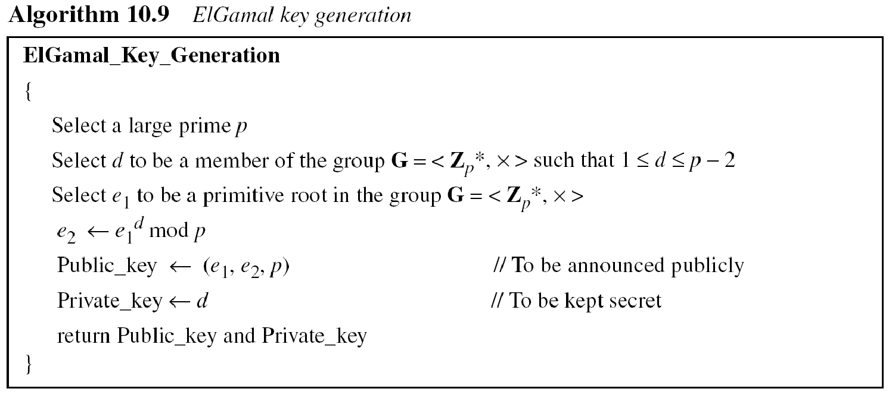
10.4.2 Continued
Key Generation

Slide 32
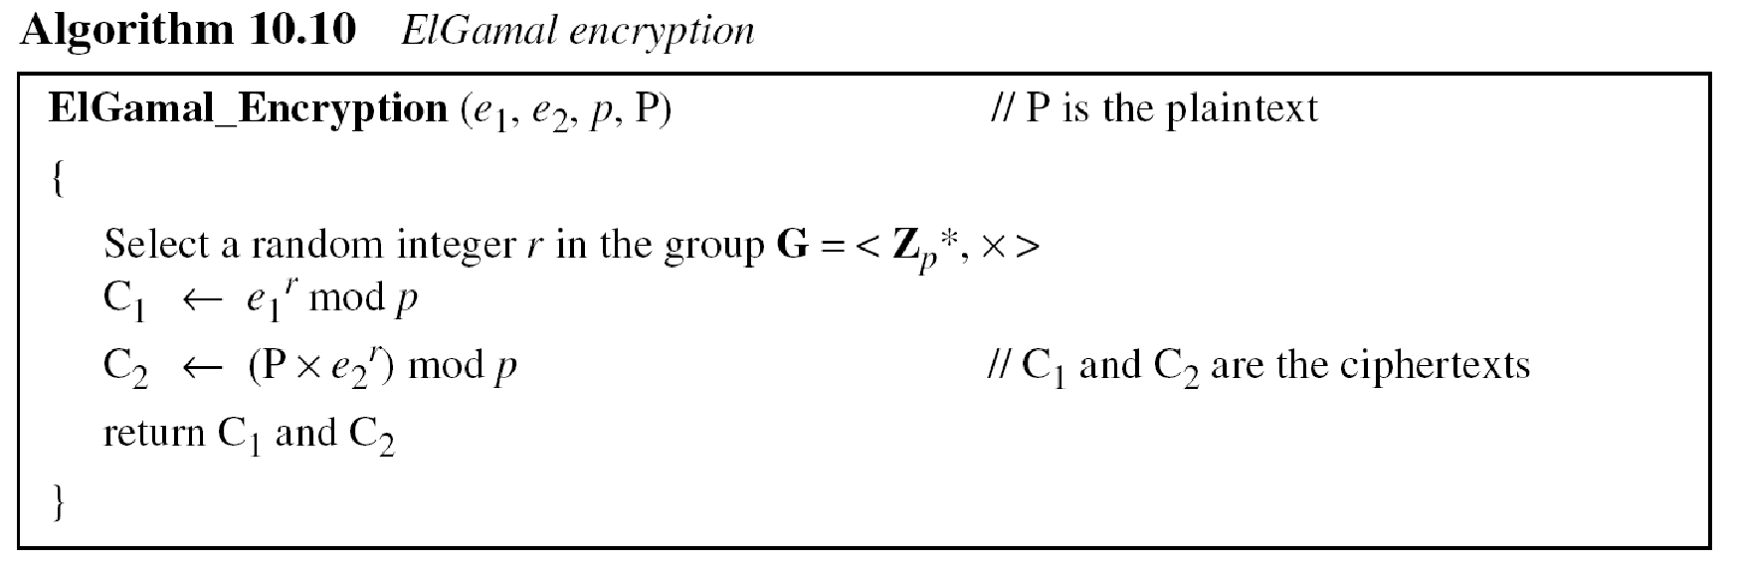
10.4.2 Continued

Slide 33
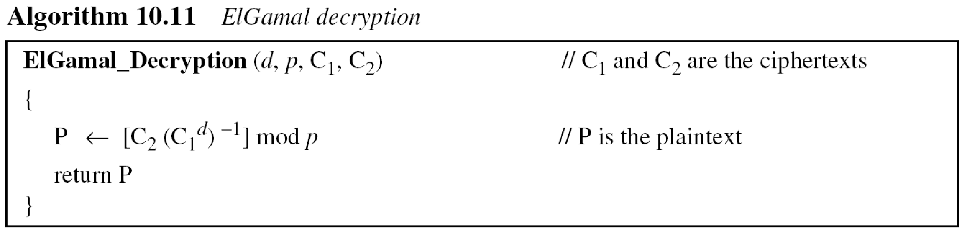
10.4.2 Continued
Note
The bit-operation complexity of encryption or decryption in ElGamal cryptosystem is polynomial.

Slide 34
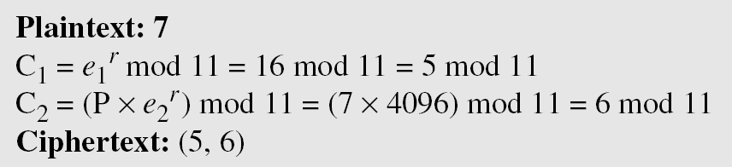
10.4.3 Continued
Example 10. 10
Here is a trivial example. Bob chooses p = 11 and e₁ = 2. and d = 3 e₂ = e₁^{d} = 8. So the public keys are (2, 8, 11) and the private key is 3. Alice chooses r = 4 and calculates C1 and C2 for the plaintext 7.
Bob receives the ciphertexts (5 and 6) and calculates the plaintext.

